Slide 1
Self-sufficient deployment: using pair programming to have fun and sell your solutions
Kristin Carr
Kris Fabick

Slide 2
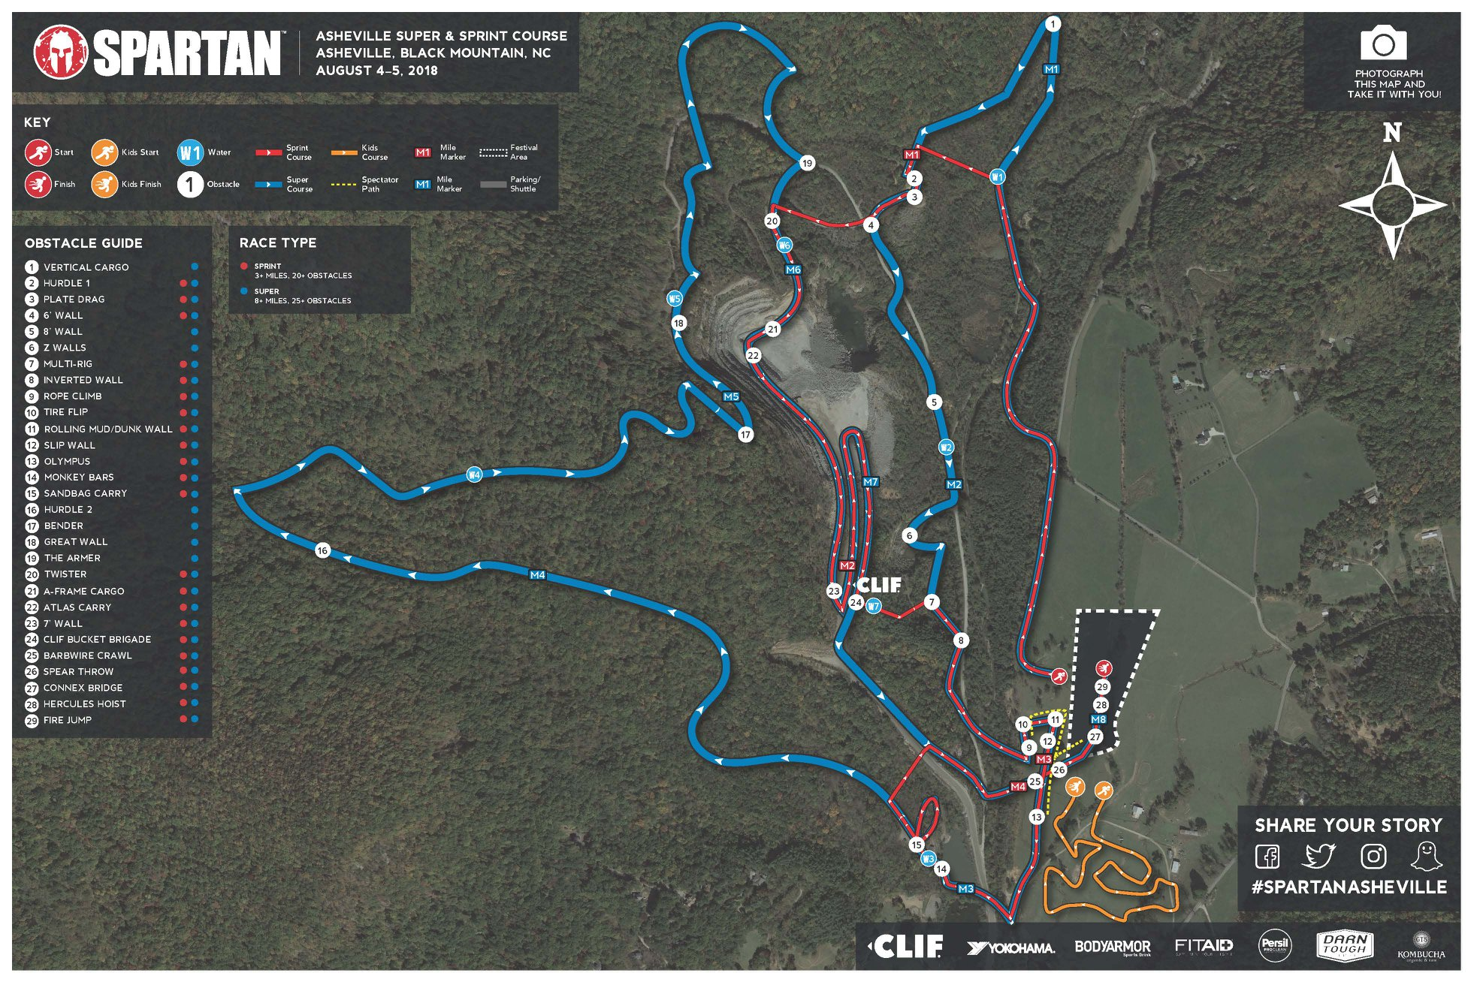
Black Mountain: Stronger Together
25+ obstacles/ 12 miles
1

Slide 3

Black Mountain: Stronger Together
25+ obstacles/ 12 miles
7 "mystery" obstacles
1

Slide 4

Black Mountain: Stronger Together
25+ obstacles/ 12 miles
7 "mystery" obstacles
1636 ft elevation change
1

Slide 5
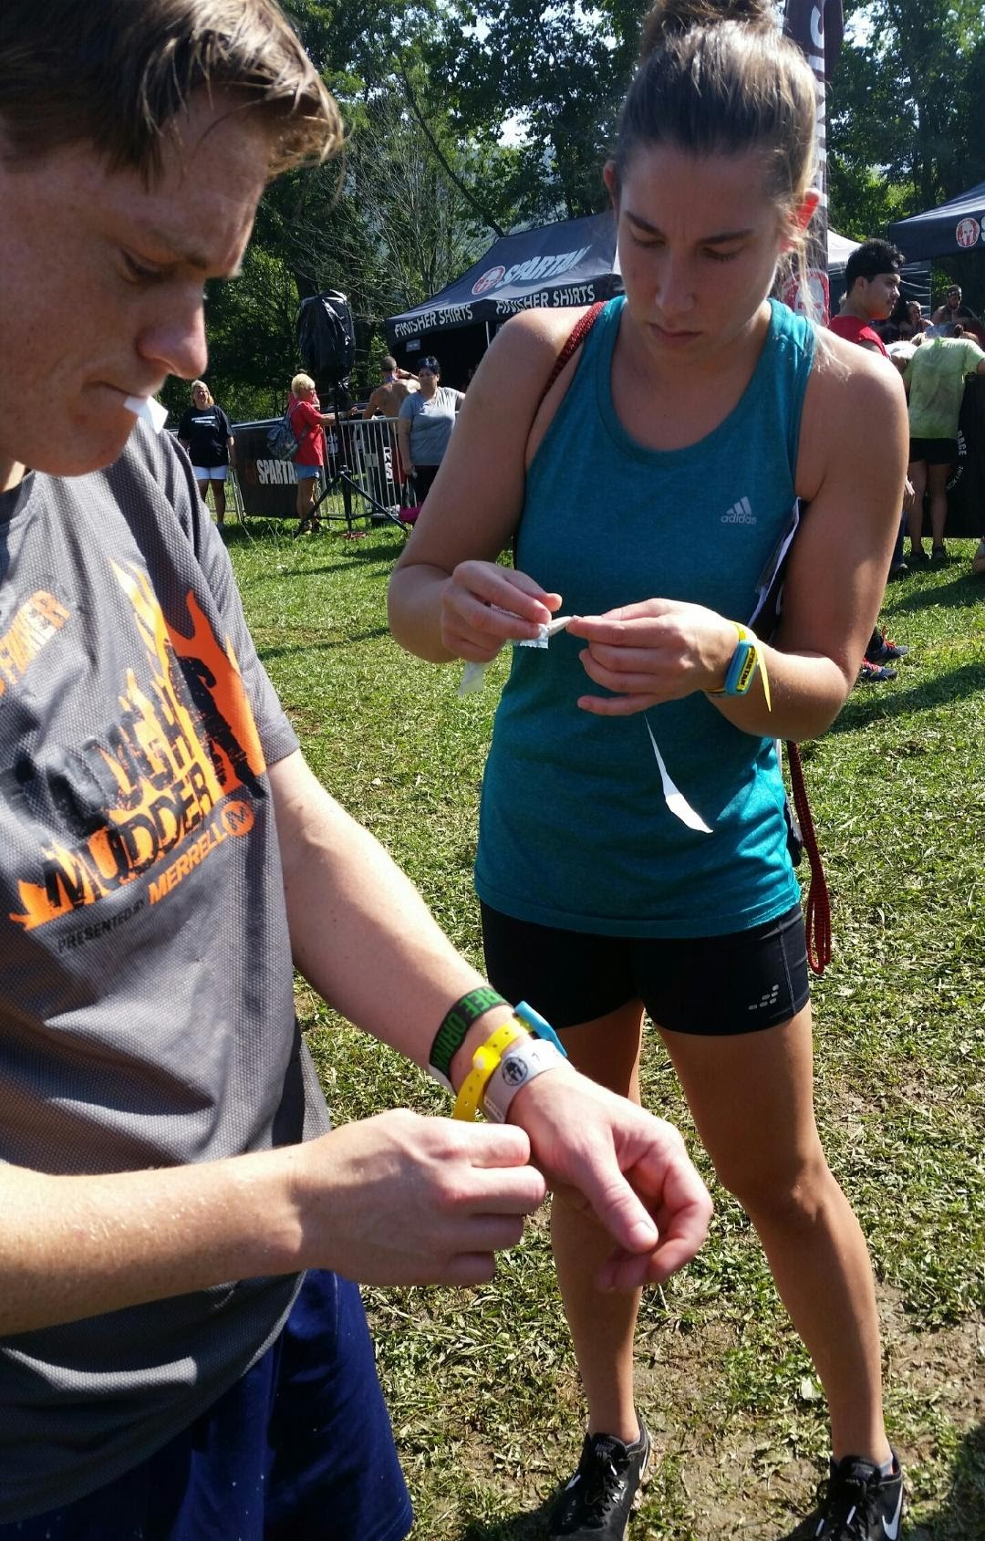
Black Mountain: Stronger Together
25+ obstacles/ 12 miles
7 "mystery" obstacles
1636 ft elevation change
Preparation (stability)
Adaptability (reactivity)
Overcome Difficulty (mindset)
1

Slide 6
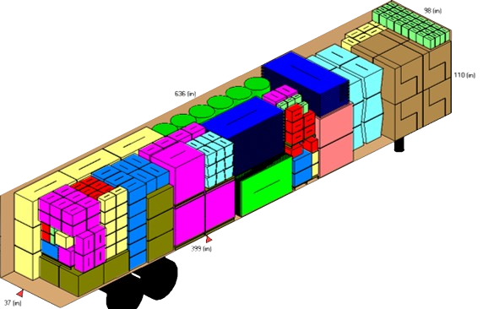

Our Spartan Race at Work
Business problem: Predict monthly “Container Fill Ratio” based on package dimensions
2

Slide 7
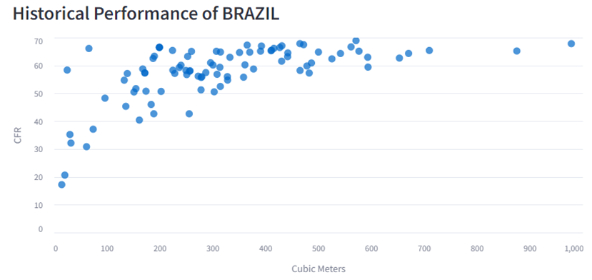
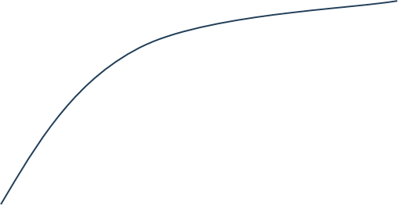
Simple, right?
7

Slide 8
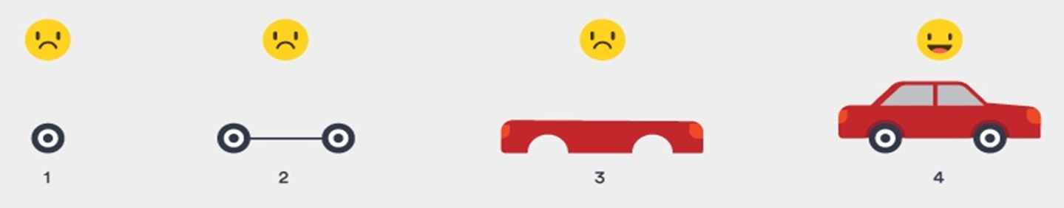
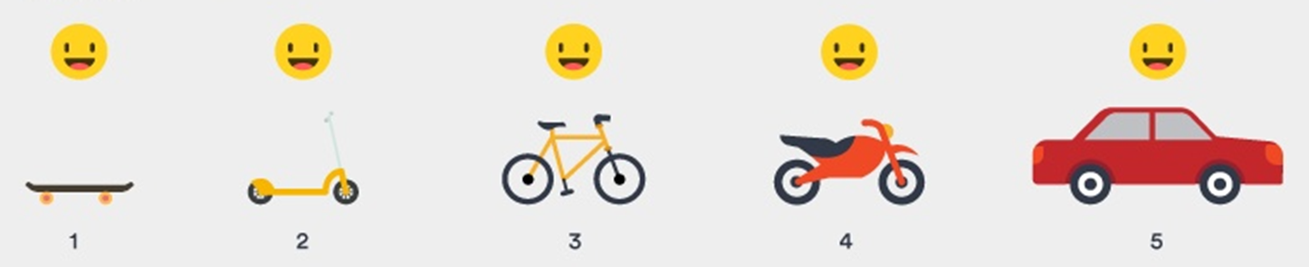
Problem 1: Solutions need to be REACTIVE
3

Slide 9


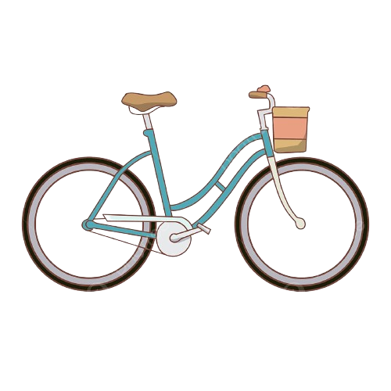
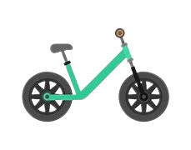
Problem 2: Solutions need to be STABLE
Stability requires sufficient support
(Or else everyone is angry crying)
4

Slide 10
Analytics Deployment Expansion Curve
Manual /
ad hoc
Local deployment
Team/Dept server deployment
Dept system deployment
Enterprise system deployment
5

Slide 11
Analytics Deployment Expansion Curve
Self-sufficient deployments
Manual /
ad hoc
Local deployment
Team/Dept server deployment
Dept system deployment
Enterprise system deployment
5

Slide 12
Analytics Deployment Expansion Curve
Reactivity
Dedicated Support (Stability)
Retain maximum reactivity with sufficient support to ensure stability
Manual /
ad hoc
Local deployment
Team/Dept server deployment
Dept system deployment
Enterprise system deployment
5

Slide 13


Embrace the Paradox: Pair Programming to the Rescue
15% more time with 15% less defects
90% preferred working in pairs
Solo developers only passed ~75% of test cases
Paired developers passed ~90% of test cases
REACTIVE
STABLE
Verwijs, C. (2024, March 15). In-depth: The costs and benefits of pair programming. Medium. https://medium.com/the-liberators/in-depth-the-costs-and-benefits-of-pair-programming-b4b54b27c6ff
6

Slide 14

How does pair programming NOT look?
Backseat driving
7

Slide 15

How does pair programming NOT look?
Backseat driving
24/7 grind
7

Slide 16

How does pair programming NOT look?
Backseat driving
24/7 grind
Hogging the keyboard
7

Slide 17

How does pair programming NOT look?
Backseat driving
24/7 grind
Hogging the keyboard
Nap time
7

Slide 18
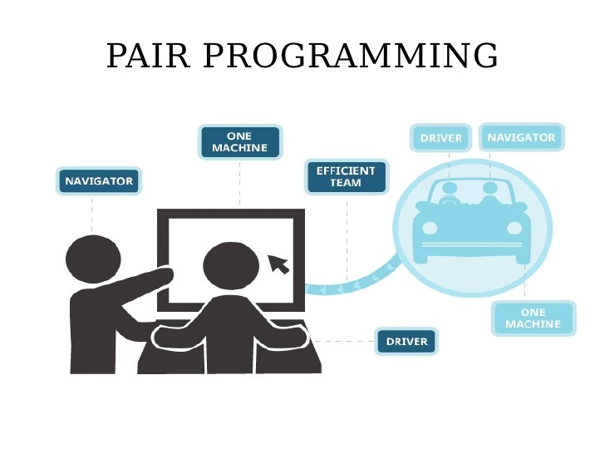
How does pair programming look?
Many approaches
Driver/navigator
8

Slide 19
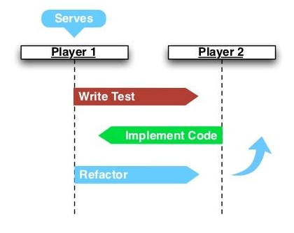
How does pair programming look?
Many approaches
Driver/navigator
Ping/Pong
"Refactoring" is the process of making the code more readable, maintainable, and efficient
8

Slide 20




How does pair programming look?
Many approaches
Driver/navigator
Ping/Pong
Unstructured Synchronous
Exploratory Analysis
Refactor
Model Building
Refactor
UI App Creation
Refactor
"Refactoring" is the process of making the code more readable, maintainable, and efficient
8

Slide 21
How does pair programming look?
Exploratory Analysis
Many approaches
Driver/navigator
Ping/Pong
Unstructured Synchronous
Unstructured Asynchronous ("Pair"allel)
UI App Creation
Model Building
Refactor
Goal:
Everyone should be able to ride the bike
Refactor
"Refactoring" is the process of making the code more readable, maintainable, and efficient
8

Slide 22





The Path to Victory
Develop Model
Pin Model Version
Create API
KF lead
KC lead
Learn together
Call API
Display Model Preds
3 weeks
+
2 weeks
+
1 day
9

Slide 23

Lesson #1: “Pairing” is a mindset, not a technique
Follow the vibe
10

Slide 24


Lesson #1: “Pairing” is a mindset, not a technique
Follow the vibe
Embrace friction
10

Slide 25


Lesson #1: “Pairing” is a mindset, not a technique
Follow the vibe
Embrace friction
Slow down to speed up
10

Slide 26
Lesson #2: Know Your Strengths; Adapt for Your Weaknesses
Before Pair Programming
After Pair Programming
11

Slide 27


Lesson #3: Create Checkpoints
Refactor often
12

Slide 28
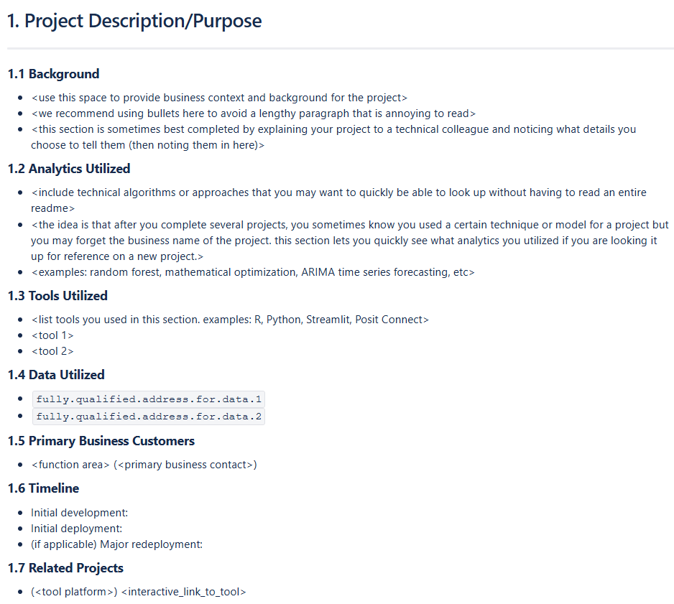
Lesson #3: Create Checkpoints
Refactor often
Implement standards
12

Slide 29

Want to Learn More?
Slides
Links to Articles about Pair Programming
Technical Details
Develop Model
Configure Posit Connect
Pin Model to Posit Connect
Create Vetiver API
Call Vetiver API
Display Model Predictions
13

Slide 30

Want to Learn More?
13

Slide 31

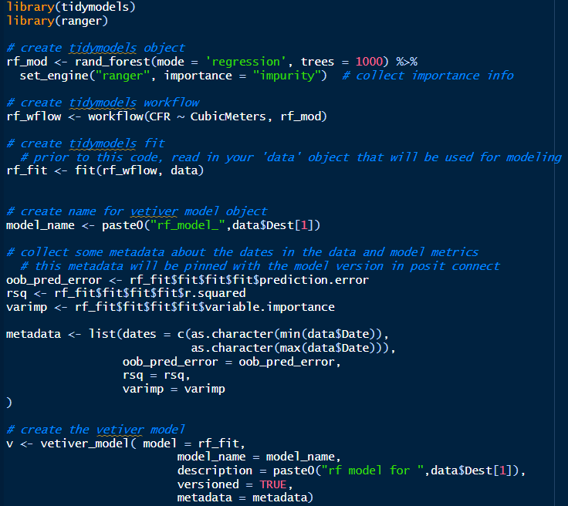
The Technical Details
Develop Model
Configure Posit Connect
Pin Model to Posit Connect
Create Vetiver API
Call Vetiver API
Display Model Predictions

Slide 32
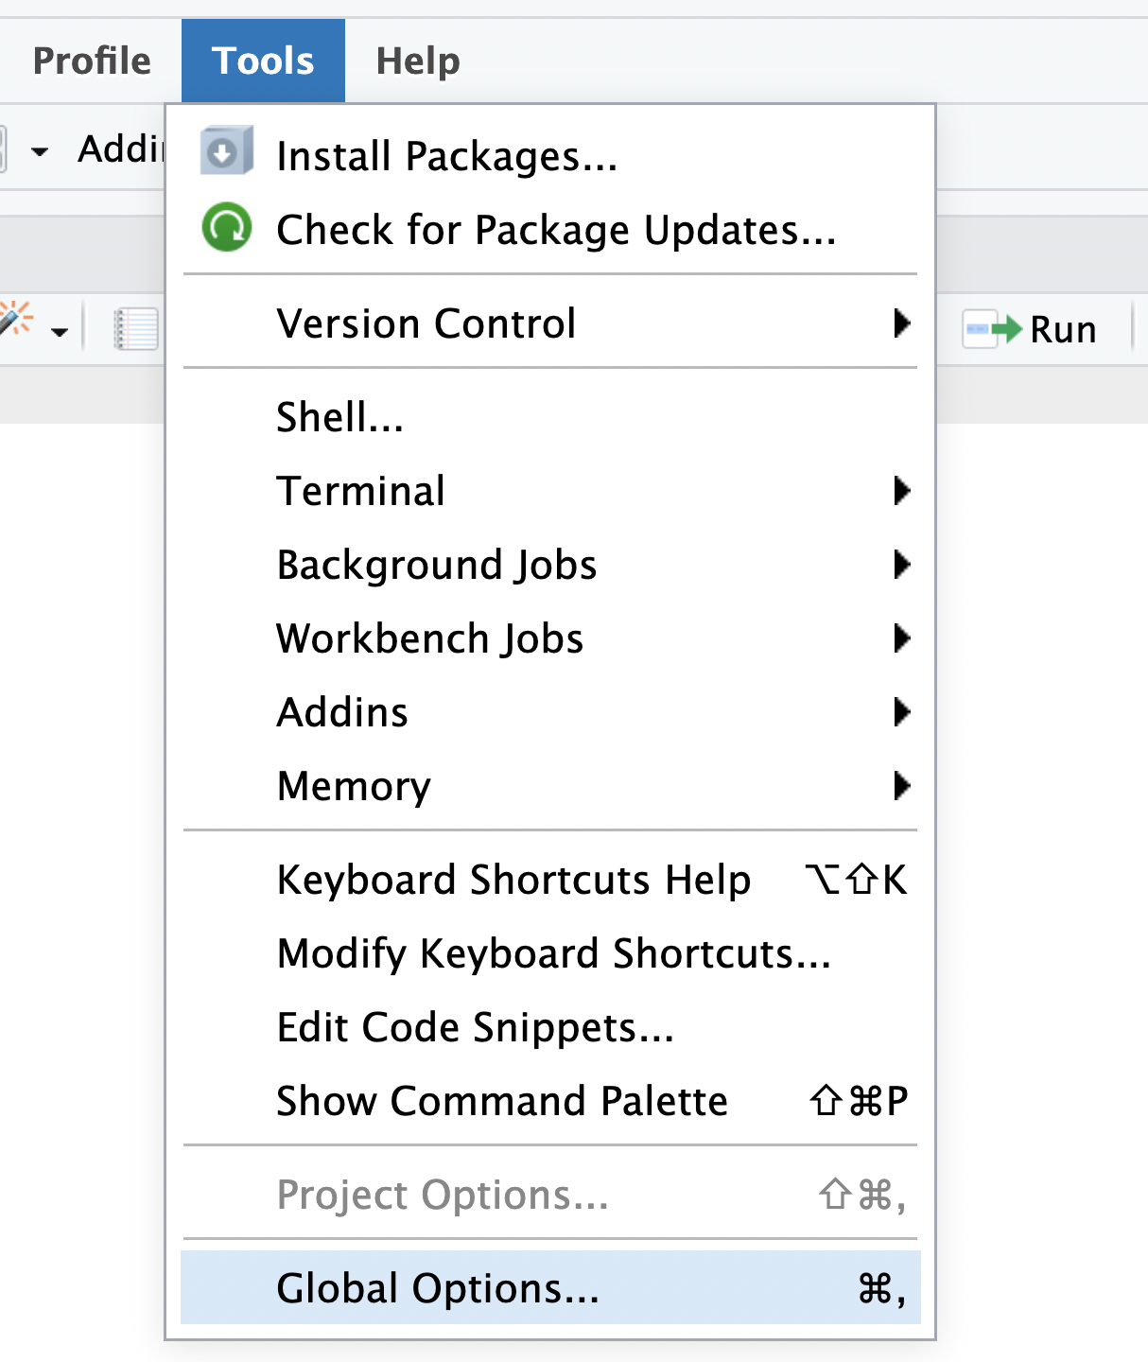
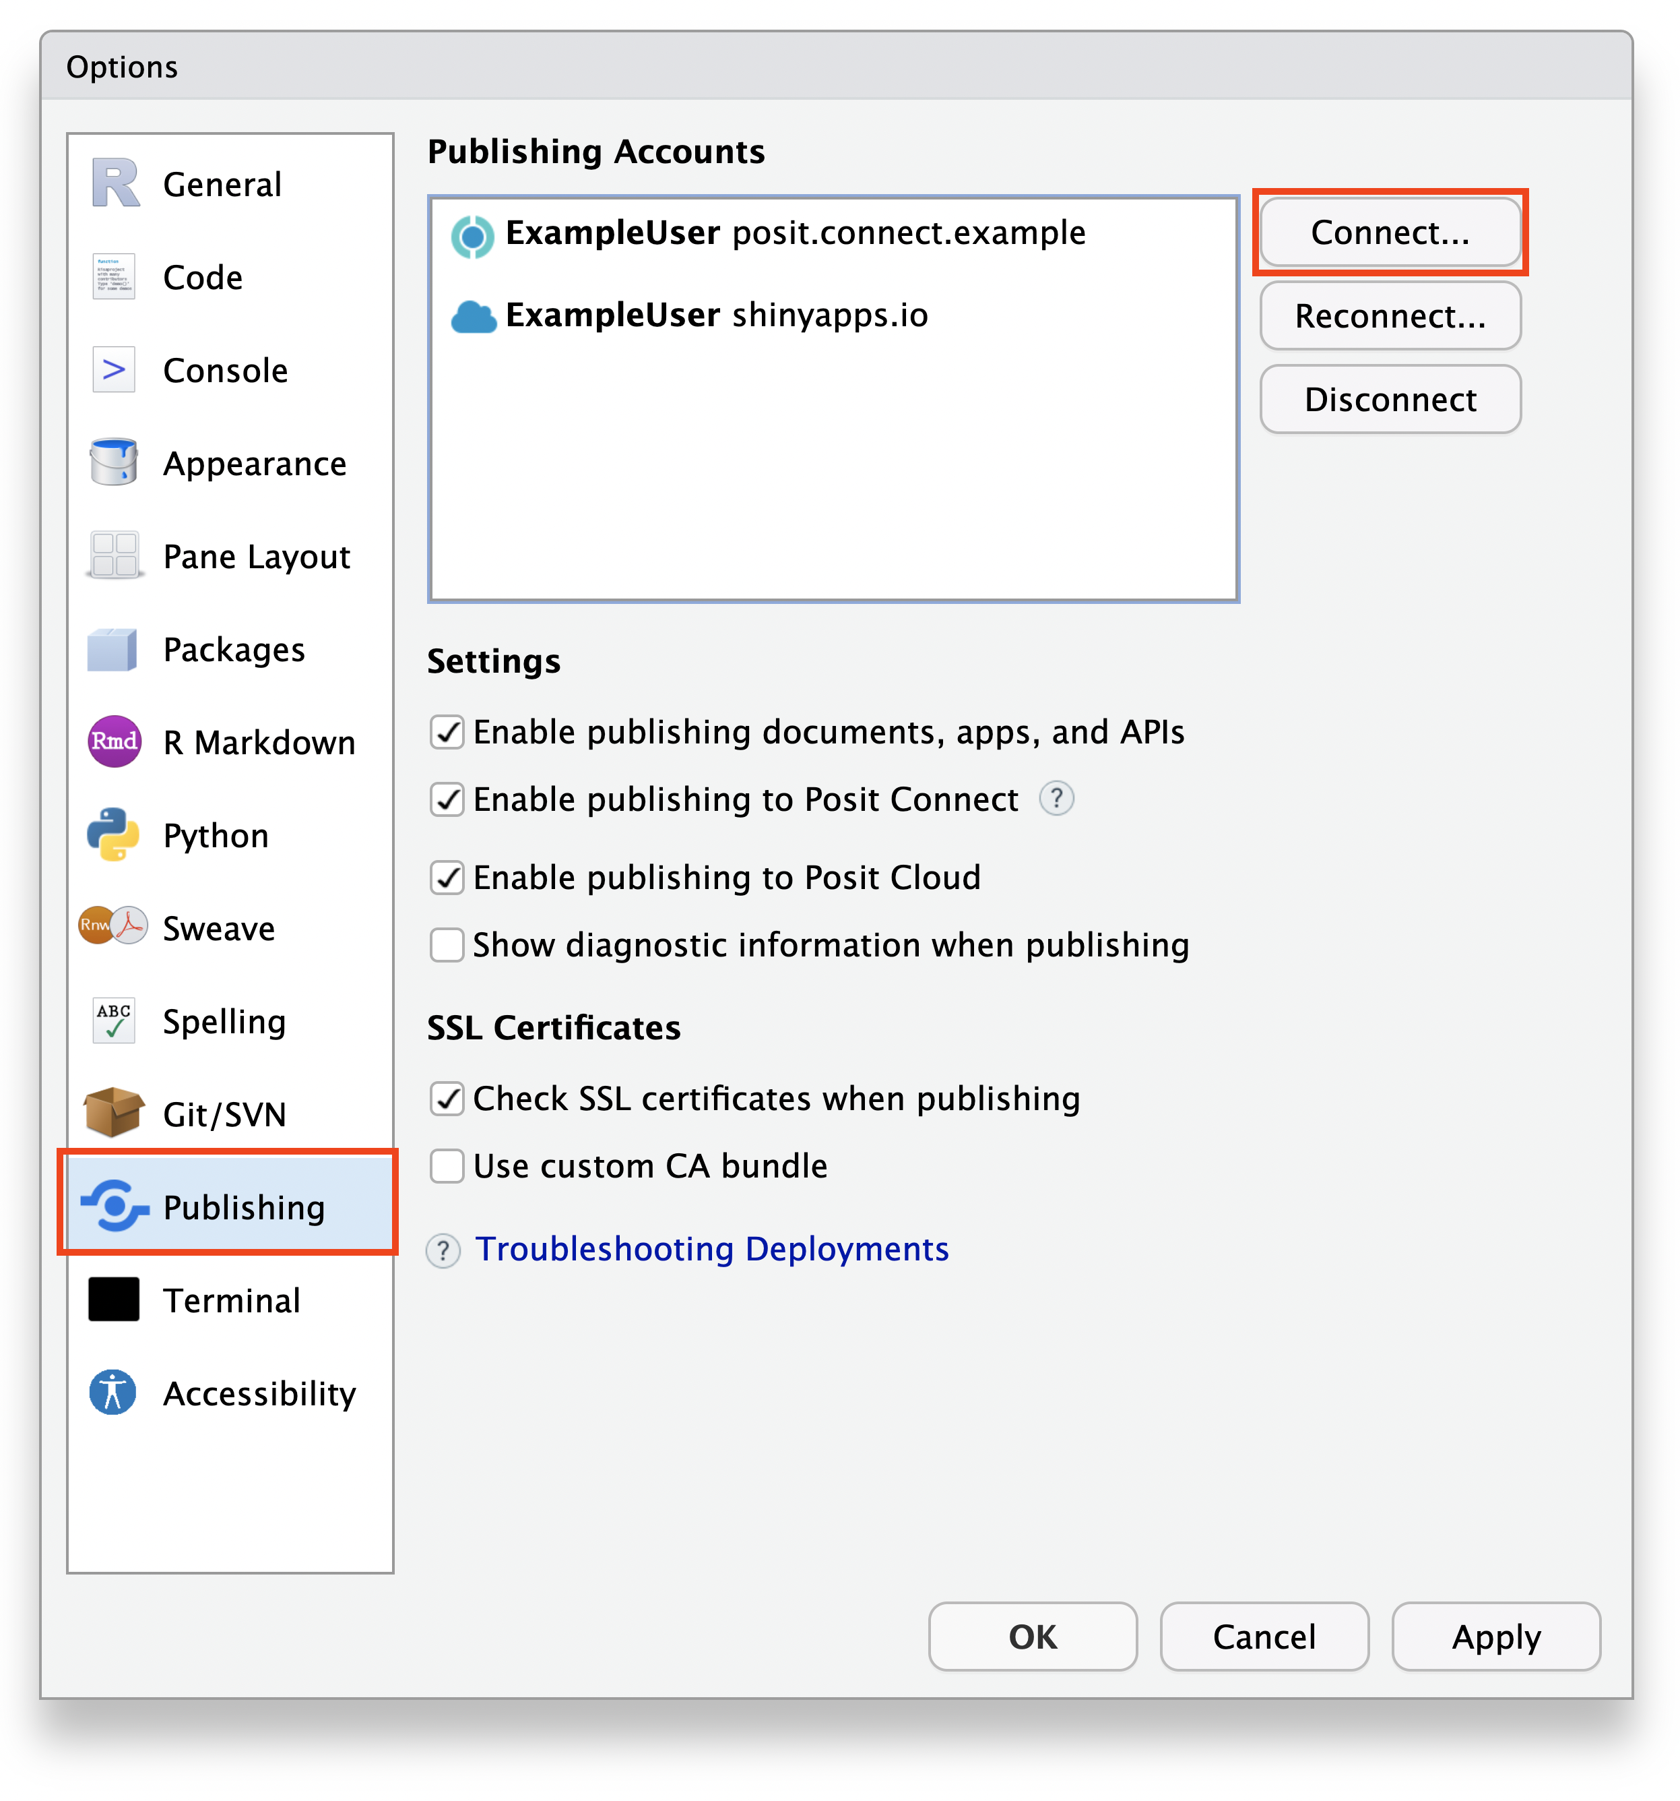
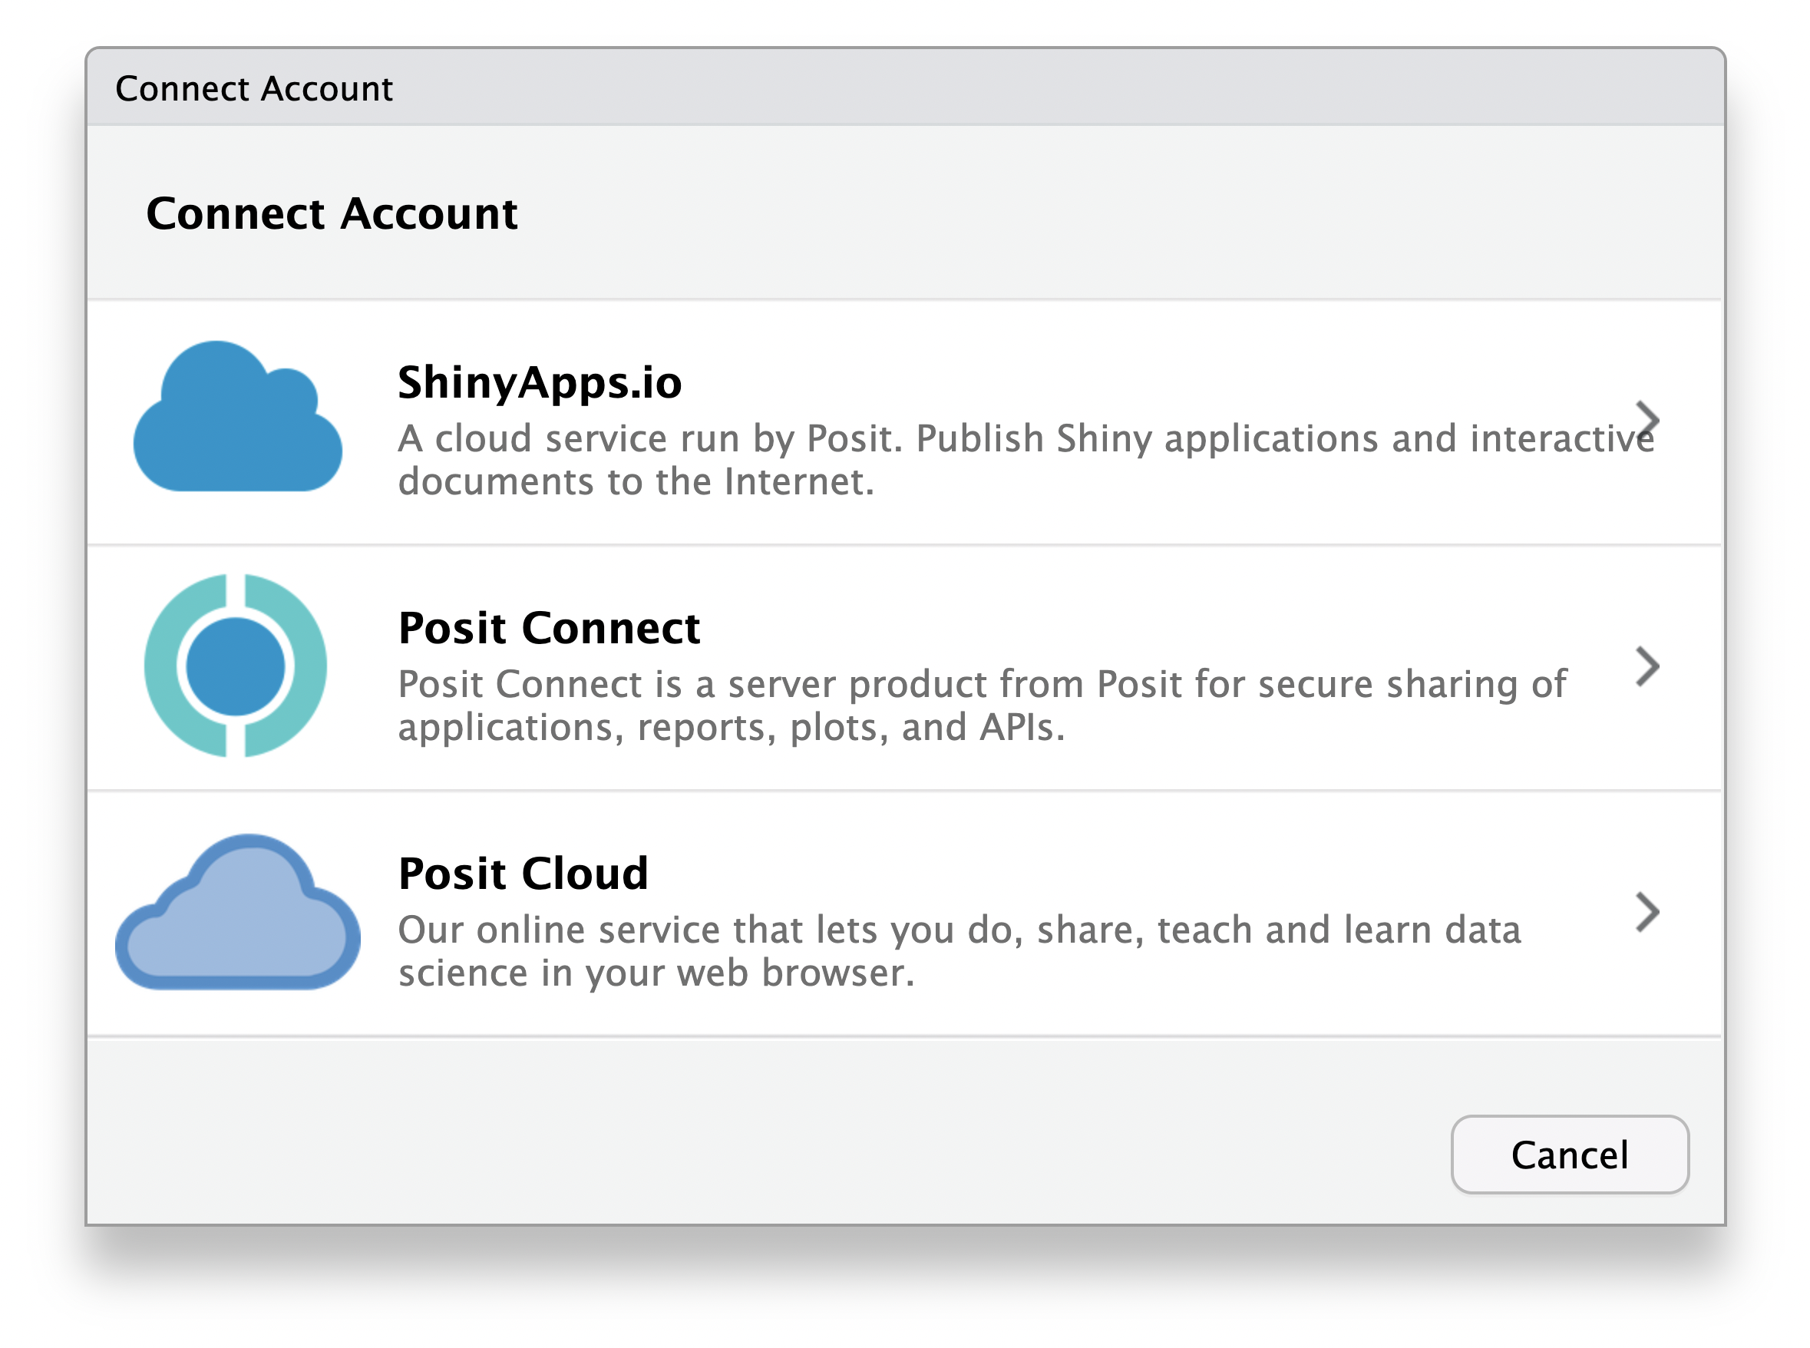
The Technical Details
Develop Model
Configure Posit Connect
Pin Model to Posit Connect
Create Vetiver API
Call Vetiver API
Display Model Predictions
https://docs.posit.co/ide/user/ide/guide/publish/connecting.html
1
2
3

Slide 33
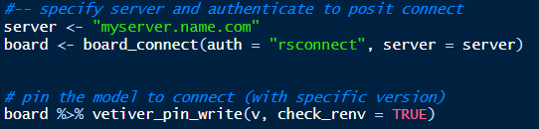
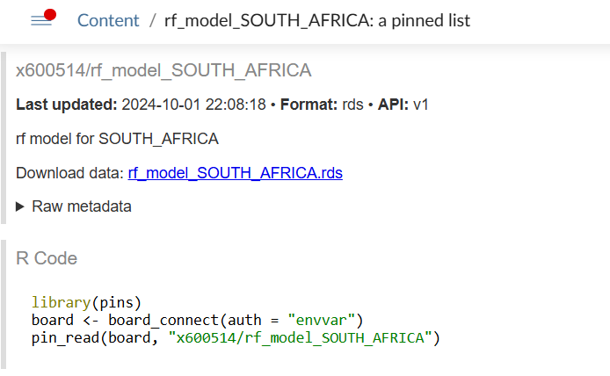
The Technical Details
Develop Model
Configure Posit Connect
Pin Model to Posit Connect
Create Vetiver API
Call Vetiver API
Display Model Predictions
R code to pin the model
Posit Connect view of pinned model
Notice the metadata section
Posit Connect provides the code you need to read the model

Slide 34
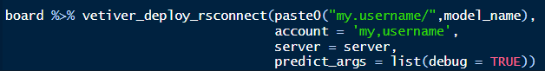
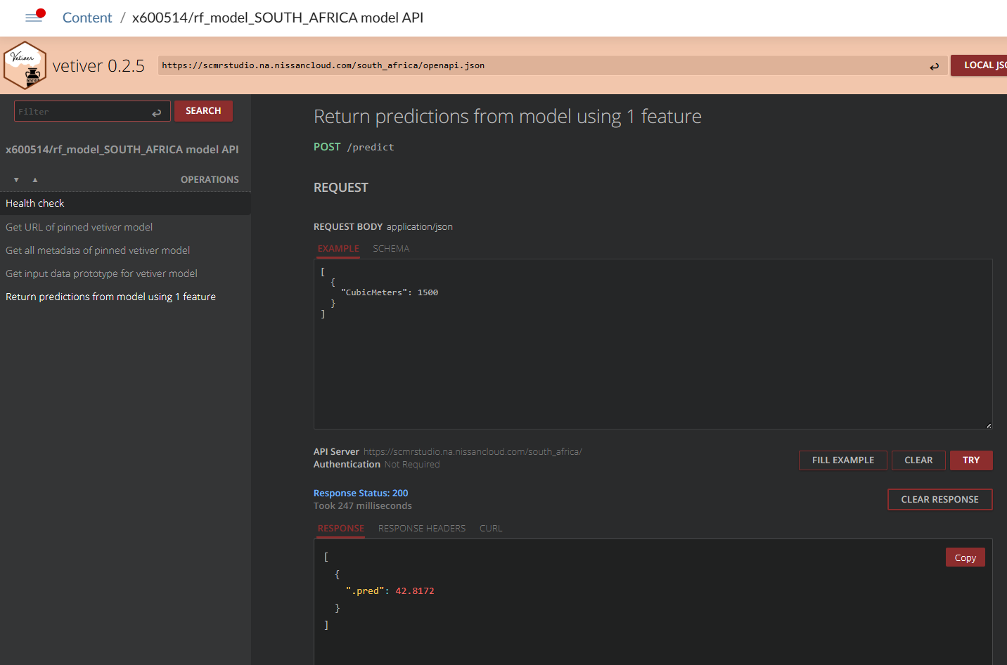
The Technical Details
https://docs.posit.co/connect/user/vetiver/
Develop Model
Configure Posit Connect
Pin Model to Posit Connect
Create Vetiver API
Call Vetiver API
Display Model Predictions
R code to create vetiver API Posit Connect view of API
Vetiver creates endpoints for:
GET /ping
GET /pin-url
GET /metadata
GET /prototype
POST /predict

Slide 35

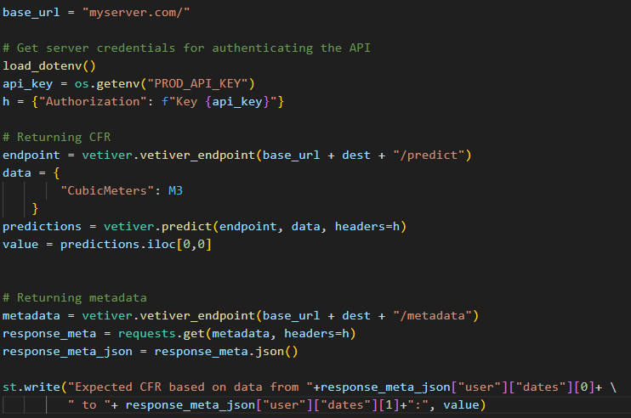
The Technical Details
Develop Model
Configure Posit Connect
Pin Model to Posit Connect
Create Vetiver API
Call Vetiver API
Display Model Predictions

Slide 36
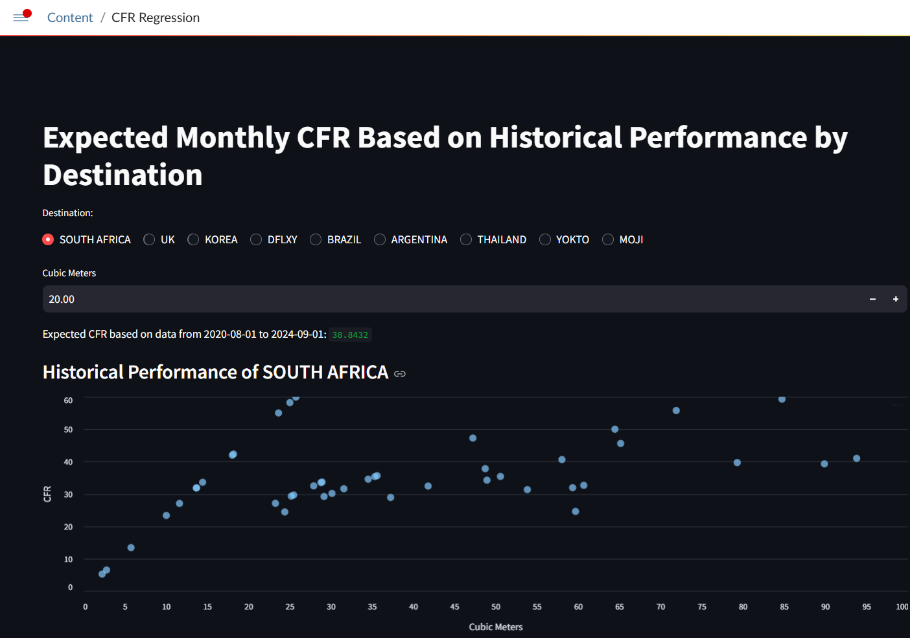
The Technical Details
Develop Model
Configure Posit Connect
Pin Model to Posit Connect
Create Vetiver API
Call Vetiver API
Display Model Predictions

